Slide 1

Chirurgia Bariatrica e Metabolica e cancro: si può parlare di prevenzione?
Amanda belluzzi
Ospedale S.maria della misericordia, UOC chirurgia generale e d’urgenza, rovigo

Slide 2

Chirurgia Bariatrica e Metabolica e cancro: si può parlare di prevenzione?
Key points
Obesity and cancer risk
Metabolic and Bariatric Surgery and Cancer Prevention
MBS and Cancer prevention: What is the Evidence?
Take Home Messages

Slide 3
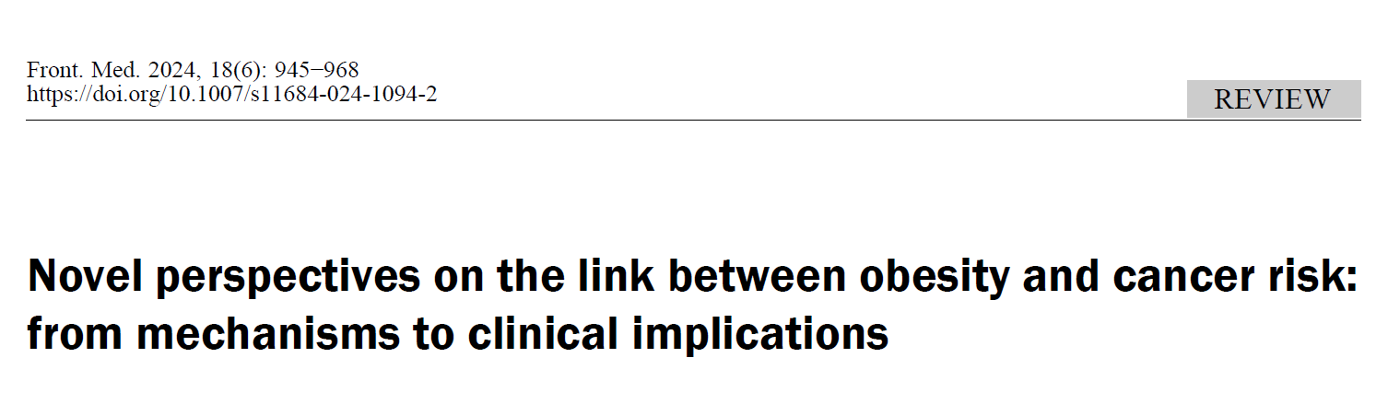
Chirurgia Bariatrica e Metabolica e cancro: si può parlare di prevenzione?
Obesity and cancer risk
2024
Shi X, Jiang A, Qiu Z, Lin A, Liu Z, Zhu L, Mou W, Cheng Q, Zhang J, Miao K, Luo P. Novel perspectives on the link between obesity and cancer risk: from mechanisms to clinical implications. Front Med. 2024 Dec;18(6):945-968.

Slide 4
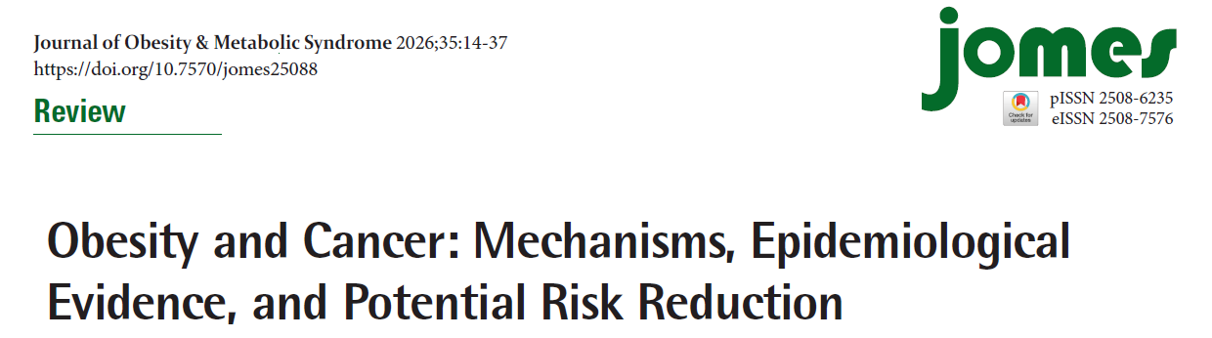
Chirurgia Bariatrica e Metabolica e cancro: si può parlare di prevenzione?
2026
Lim JS, Kim S, Cho IY, Shin DW. Obesity and Cancer: Mechanisms, Epidemiological Evidence, and Potential Risk Reduction. J Obes Metab Syndr. 2026 Jan 30;35(1):14-37.

Slide 5
Chirurgia Bariatrica e Metabolica e cancro: si può parlare di prevenzione?
Obesity and cancer risk
2024
Shi X, Jiang A, Qiu Z, Lin A, Liu Z, Zhu L, Mou W, Cheng Q, Zhang J, Miao K, Luo P. Novel perspectives on the link between obesity and cancer risk: from mechanisms to clinical implications. Front Med. 2024 Dec;18(6):945-968.

Slide 6
Chirurgia Bariatrica e Metabolica e cancro: si può parlare di prevenzione?
Obesity and cancer risk
2024
Shi X, Jiang A, Qiu Z, Lin A, Liu Z, Zhu L, Mou W, Cheng Q, Zhang J, Miao K, Luo P. Novel perspectives on the link between obesity and cancer risk: from mechanisms to clinical implications. Front Med. 2024 Dec;18(6):945-968.

Slide 7
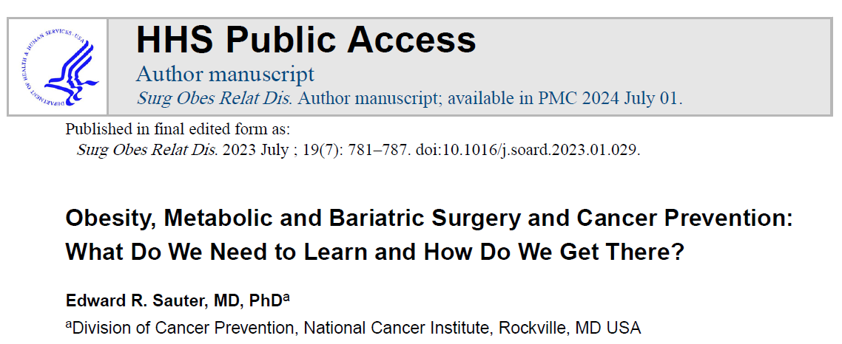
Chirurgia Bariatrica e Metabolica e cancro: si può parlare di prevenzione?
Obesity and cancer risk
2023
Sauter ER. Obesity, metabolic and bariatric surgery, and cancer prevention: what do we need to learn and how do we get there? Surg Obes Relat Dis. 2023 Jul;19(7):781-787.

Slide 8
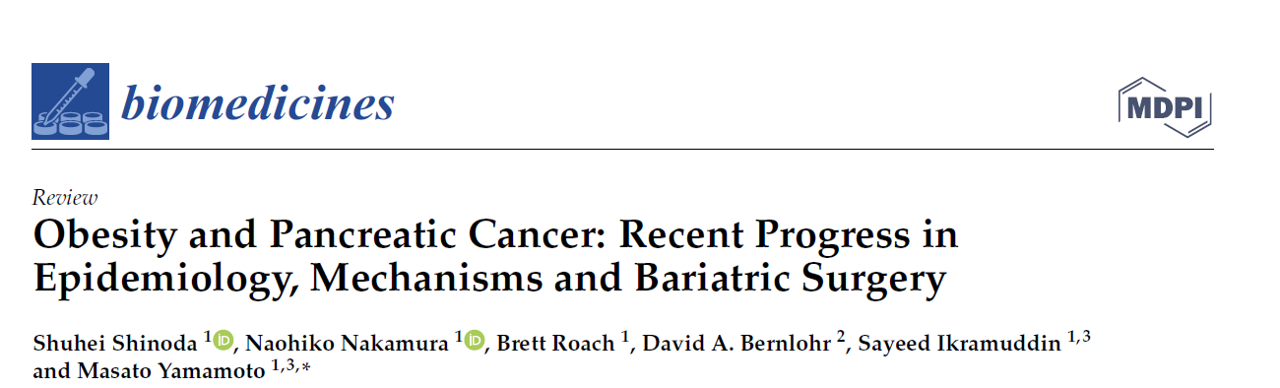
Chirurgia Bariatrica e Metabolica e cancro: si può parlare di prevenzione?
Obesity and cancer risk
2022
Summary of hazard ratio (HR) for pancreatic ductal adenocarcinoma (PDAC) incidence associated with obesity (above) and bariatric surgery (below)
Shinoda S, Nakamura N, Roach B, Bernlohr DA, Ikramuddin S, Yamamoto M. Obesity and Pancreatic Cancer: Recent Progress in Epidemiology, Mechanisms and Bariatric Surgery. Biomedicines. 2022 May 31;10(6):1284.

Slide 9
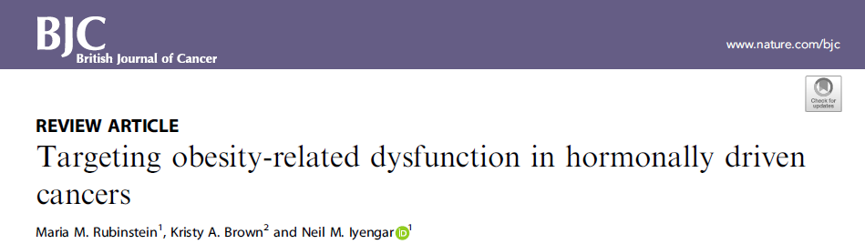
Chirurgia Bariatrica e Metabolica e cancro: si può parlare di prevenzione?
Obesity and cancer risk
2021
Rubinstein MM, Brown KA, Iyengar NM. Targeting obesity-related dysfunction in hormonally driven cancers. Br J Cancer. 2021 Aug;125(4):495-509.

Slide 10
Chirurgia Bariatrica e Metabolica e cancro: si può parlare di prevenzione?
Obesity and cancer risk
2021
Rubinstein MM, Brown KA, Iyengar NM. Targeting obesity-related dysfunction in hormonally driven cancers. Br J Cancer. 2021 Aug;125(4):495-509.

Slide 11
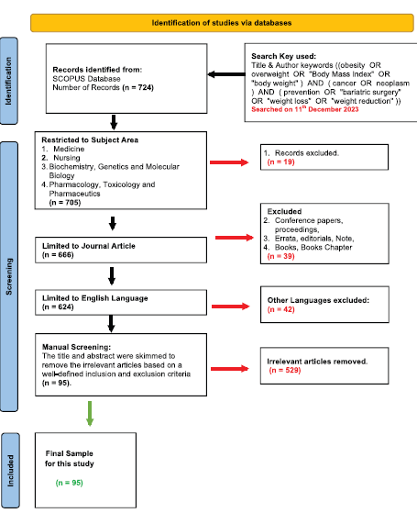
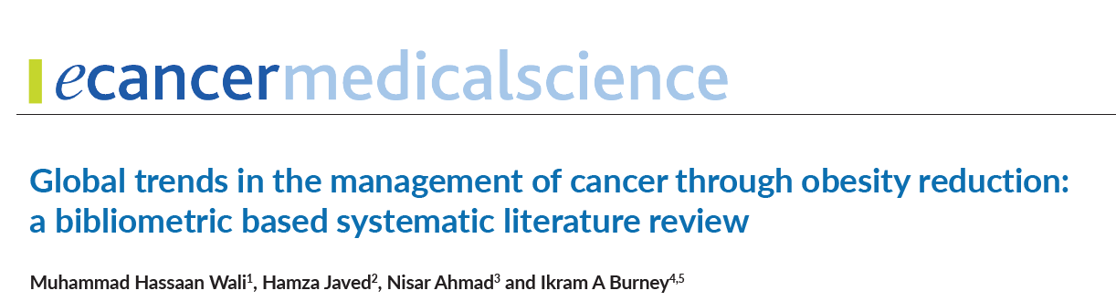
Chirurgia Bariatrica e Metabolica e cancro: si può parlare di prevenzione?
2025
Metabolic and Bariatric Surgery and Cancer Prevention
Wali MH, Javed H, Ahmad N, Burney IA. Global trends in the management of cancer through obesity reduction: a bibliometric based systematic literature review. Ecancermedicalscience. 2025 Feb 25;19:1857.

Slide 12
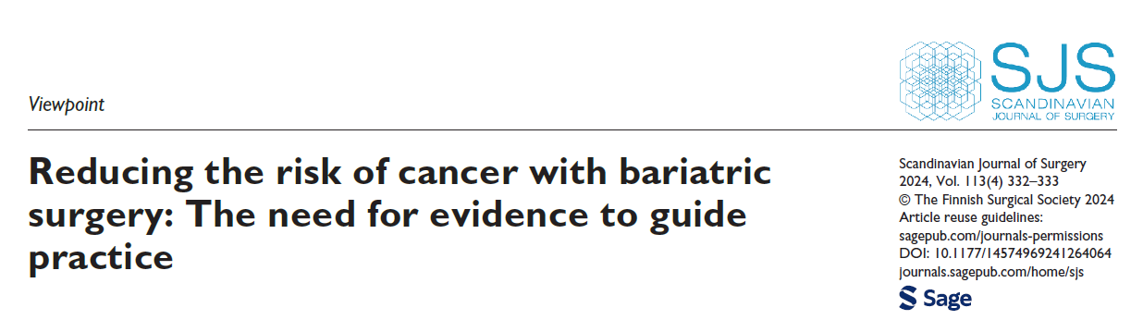

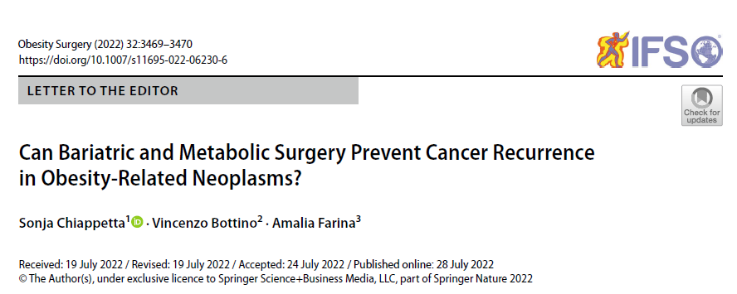
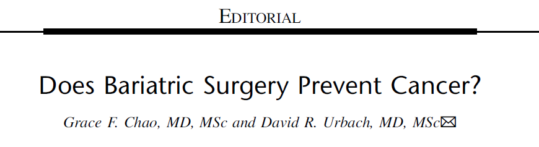
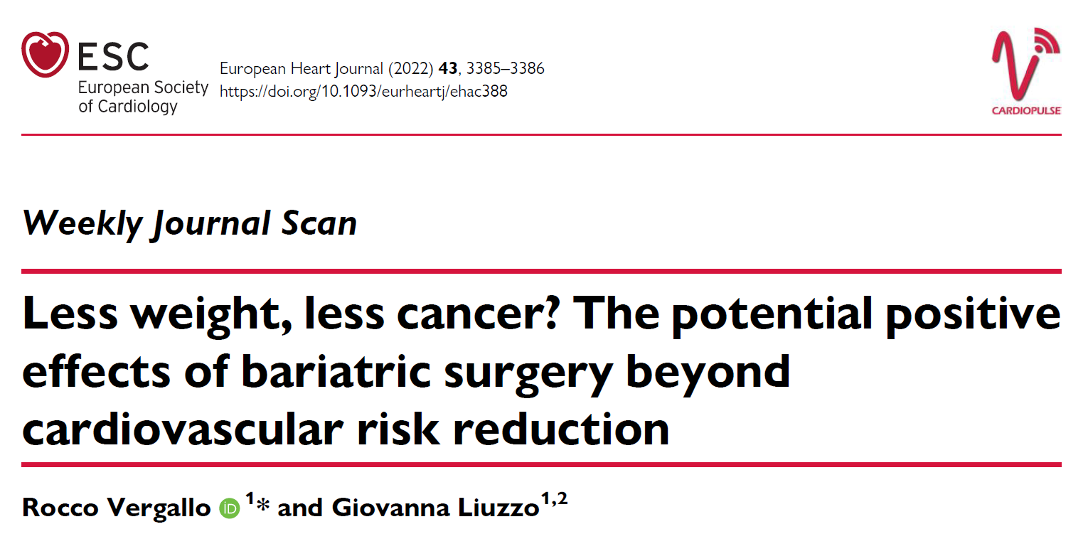
Chirurgia Bariatrica e Metabolica e cancro: si può parlare di prevenzione?
2025
Metabolic and Bariatric Surgery and Cancer Prevention
Saeed U, Yaqub S, Barreto SG, Pandol S, Mala T. Reducing the risk of cancer with bariatric surgery: The need for evidence to guide practice. Scand J Surg. 2024 Dec;113(4):332-333.
Chiappetta S, Bottino V, Farina A. Can Bariatric and Metabolic Surgery Prevent Cancer Recurrence in Obesity-Related Neoplasms? Obes Surg. 2022 Oct;32(10):3469-3470.
Chiappetta S, Bottino V. Obesity-associated cancer prevention. Lancet Healthy Longev. 2023 Oct;4(10):e520-e521.
Vergallo R, Liuzzo G. Less weight, less cancer? The potential positive effects of bariatric surgery beyond cardiovascular risk reduction. Eur Heart J. 2022 Sep 21;43(36):3385-3386.
Chao GF, Urbach DR. Does Bariatric Surgery Prevent Cancer? Ann Surg. 2022 Jan 1;275(1):7-8.

Slide 13
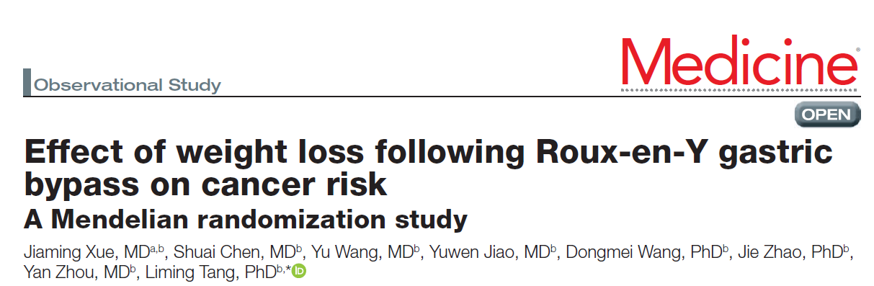
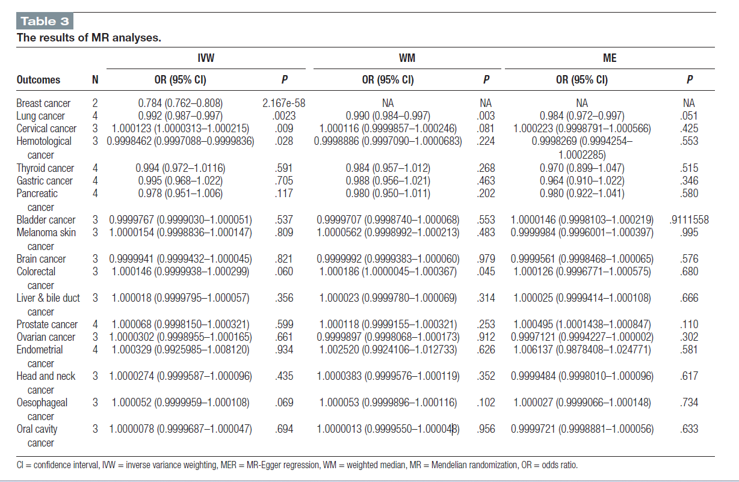
Chirurgia Bariatrica e Metabolica e cancro: si può parlare di prevenzione?
2025
Metabolic and Bariatric Surgery and Cancer Prevention
Xue J, Chen S, Wang Y, Jiao Y, Wang D, Zhao J, Zhou Y, Tang L. Effect of weight loss following Roux-en-Y gastric bypass on cancer risk: A Mendelian randomization study. Medicine (Baltimore). 2025 Jan 31;104(5):e41351.

Slide 14
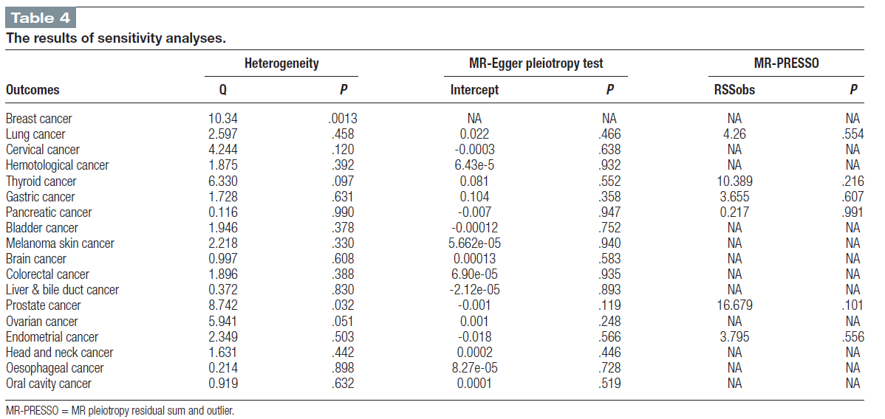
Chirurgia Bariatrica e Metabolica e cancro: si può parlare di prevenzione?
2025
Metabolic and Bariatric Surgery and Cancer Prevention
Weight loss following RYGB is associated with a decreased risk of breast, lung, and hematologic cancers, while potentially increasing the risk of cervical cancer.
In terms of cancer prevention, RYGB may be achieved through mechanisms such as reducing excessive inflammation, improving insulin resistance, and regulating levels of sex hormones and adipokines.
These results demonstrate that weight loss following RYGB reduces the risk of breast and lung cancer and suggest that it may play a potential role in reducing the risk of hematological cancer and increasing the risk of cervical cancer.
Xue J, Chen S, Wang Y, Jiao Y, Wang D, Zhao J, Zhou Y, Tang L. Effect of weight loss following Roux-en-Y gastric bypass on cancer risk: A Mendelian randomization study. Medicine (Baltimore). 2025 Jan 31;104(5):e41351.

Slide 15
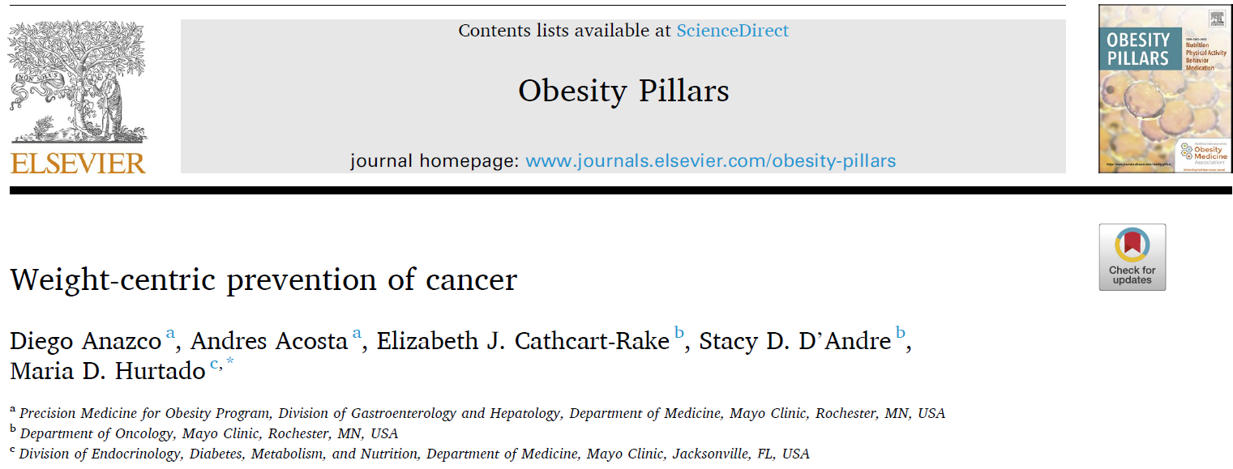
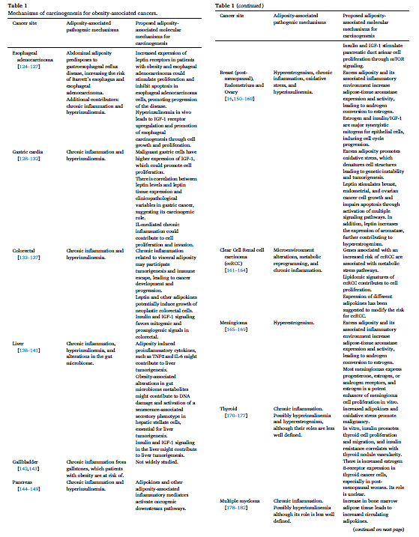
Chirurgia Bariatrica e Metabolica e cancro: si può parlare di prevenzione?
Metabolic and Bariatric Surgery and Cancer Prevention
2024
Obesity increases cancer risk in different anatomical locations through multiple mechanisms.
Weight-loss interventions can decrease cancer risk in patients with excess adiposity, with the most evidence available for post-menopausal women.
There is some conflicting data in terms of cancer protective effect after bariatric surgery for certain anatomical locations.
Anazco D, Acosta A, Cathcart-Rake EJ, D'Andre SD, Hurtado MD. Weight-centric prevention of cancer. Obes Pillars. 2024 Mar 5;10:100106.

Slide 16
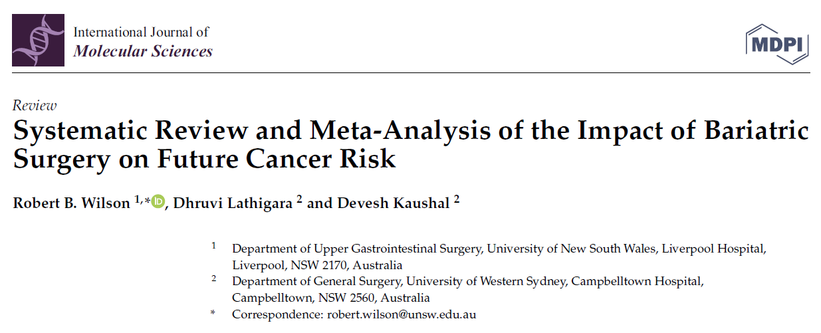
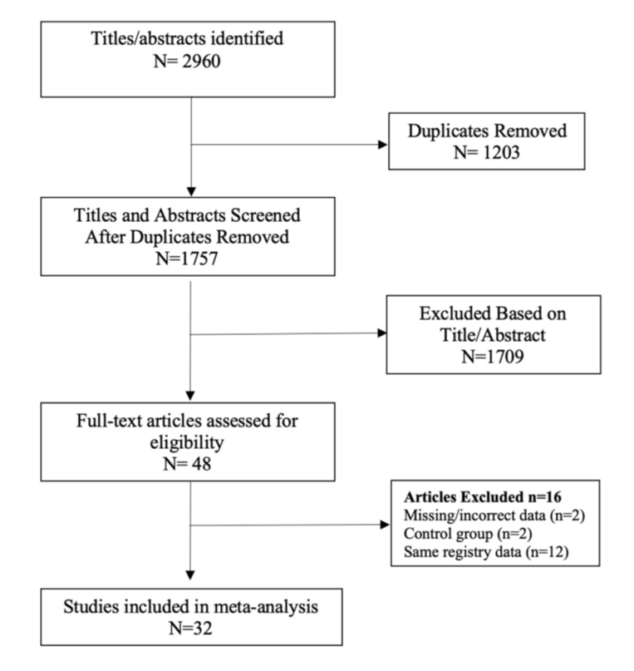
Chirurgia Bariatrica e Metabolica e cancro: si può parlare di prevenzione?
2023
Wilson RB, Lathigara D, Kaushal D. Systematic Review and Meta-Analysis of the Impact of Bariatric Surgery on Future Cancer Risk. Int J Mol Sci. 2023 Mar 24;24(7):6192.

Slide 17
Chirurgia Bariatrica e Metabolica e cancro: si può parlare di prevenzione?
2023
Cancer-related mortality
Wilson RB, Lathigara D, Kaushal D. Systematic Review and Meta-Analysis of the Impact of Bariatric Surgery on Future Cancer Risk. Int J Mol Sci. 2023 Mar 24;24(7):6192.

Slide 18
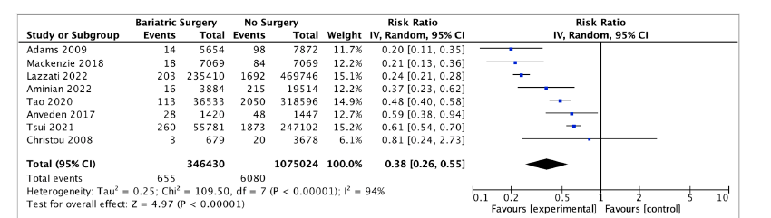
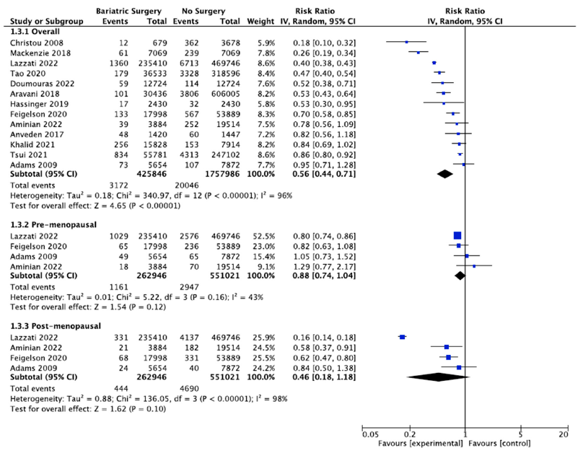
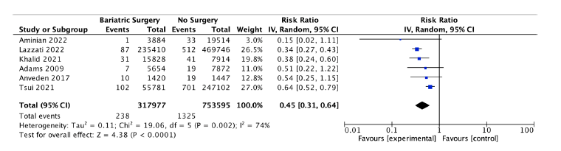
Chirurgia Bariatrica e Metabolica e cancro: si può parlare di prevenzione?
2023
Endometrial Cancer incidence
Ovarian Cancer incidence
Breast Cancer incidence
Oesophageal adenocarcinoma incidence
Wilson RB, Lathigara D, Kaushal D. Systematic Review and Meta-Analysis of the Impact of Bariatric Surgery on Future Cancer Risk. Int J Mol Sci. 2023 Mar 24;24(7):6192.

Slide 19
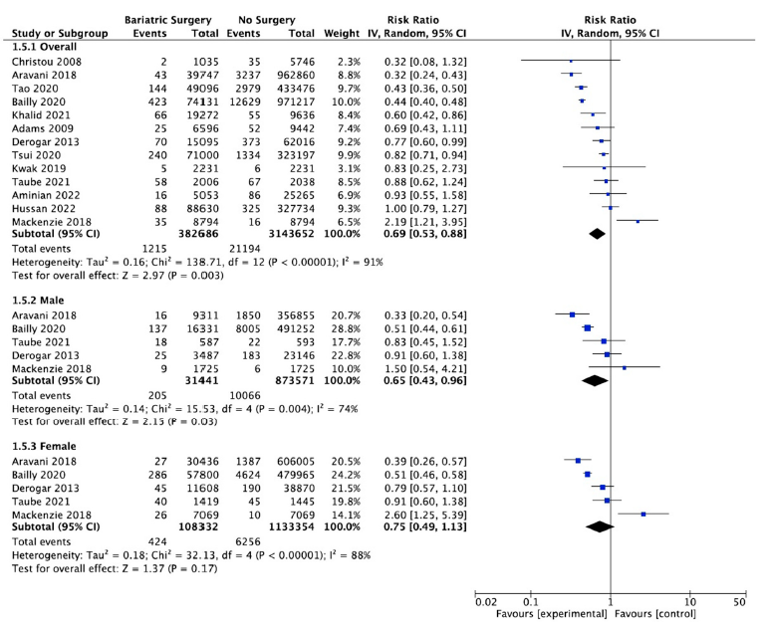
Chirurgia Bariatrica e Metabolica e cancro: si può parlare di prevenzione?
2023
Hepatocellular carcinoma incidence
Kidney cancer incidence
Colo-rectal cancer incidence
Gallbladder cancer incidence
Wilson RB, Lathigara D, Kaushal D. Systematic Review and Meta-Analysis of the Impact of Bariatric Surgery on Future Cancer Risk. Int J Mol Sci. 2023 Mar 24;24(7):6192.

Slide 20
Chirurgia Bariatrica e Metabolica e cancro: si può parlare di prevenzione?
2023
The current systematic review and meta-analysis demonstrated a reduction in the overall incidence of cancer (RR 0.62, 95% CI 0.46–0.84, p < 0.002) and OAC (RR 0.59, 95% CI 0.39–0.90, p = 0.01) as well as reduced overall cancer-associated mortality (RR 0.51, 95% CI 0.42–0.62, p < 0.00001), in patients who received bariatric surgery.
In the subgroup metaanalysis, seven OACs (breast, endometrial, ovarian, hepatocellular, pancreatic, gallbladder and colorectal cancer) had significant reductions in incidence after bariatric surgery, but this risk reduction was not demonstrated for renal, thyroid, prostate, oesophageal or gastric cancers or for multiple myeloma.
Wilson RB, Lathigara D, Kaushal D. Systematic Review and Meta-Analysis of the Impact of Bariatric Surgery on Future Cancer Risk. Int J Mol Sci. 2023 Mar 24;24(7):6192.

Slide 21
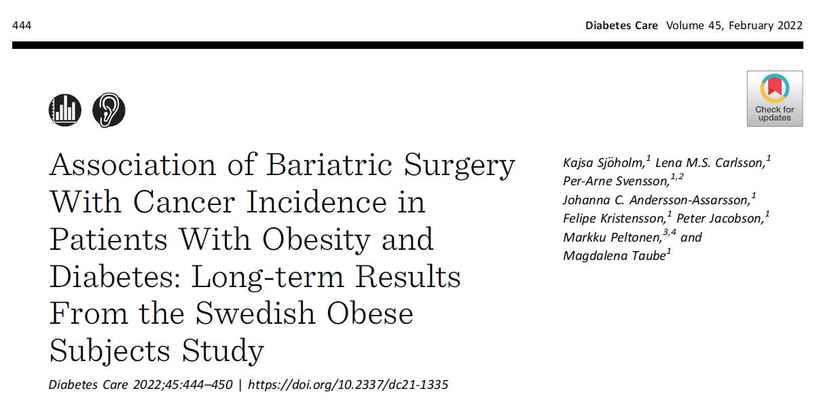
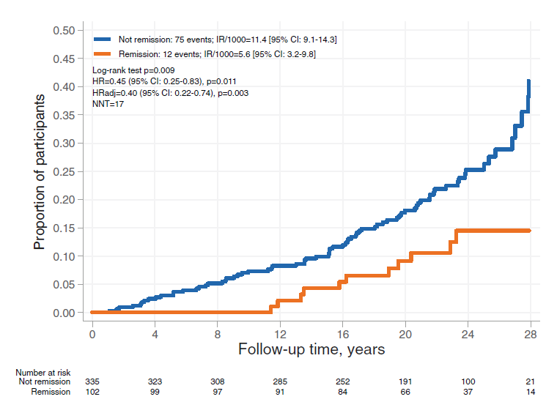
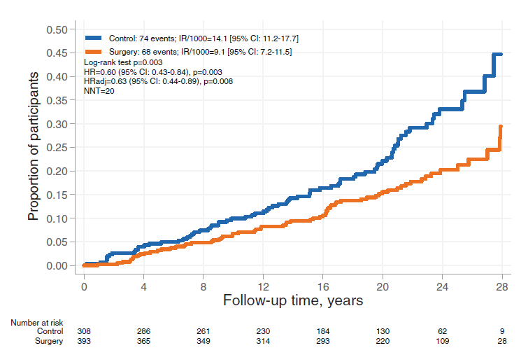
Chirurgia Bariatrica e Metabolica e cancro: si può parlare di prevenzione?
Kaplan-Meier estimates of cumulative incidence of first-time cancer events stratified by 10-year remission status in surgery and control participants combined.
2022
During follow-up, the incidence rate for first-time cancer was 9.1 per 1,000 person- years in patients with obesity and diabetes treated with MBS and 14.1 per 1,000 person-years in patients treated with usual obesity care
Moreover, surgery was associated with reduced cancer incidence in women , although the sex-treatment interaction was nonsignificant.
In addition, diabetes remission at the 10-year follow- up was associated with reduced cancer incidence (0.40 [0.22–0.74],P 5 0.003).
Kaplan-Meier estimates of cumulative incidence of first-time cancer events in control and surgery participants with obesity and diabetes
Sjöholm K, Carlsson LMS, Svensson PA, Andersson-Assarsson JC, Kristensson F, Jacobson P, Peltonen M, Taube M. Association of Bariatric Surgery With Cancer Incidence in Patients With Obesity and Diabetes: Long-term Results From the Swedish Obese Subjects Study. Diabetes Care. 2022 Feb 1;45(2):444-450.

Slide 22
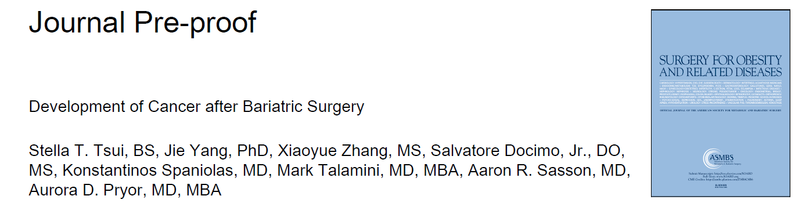
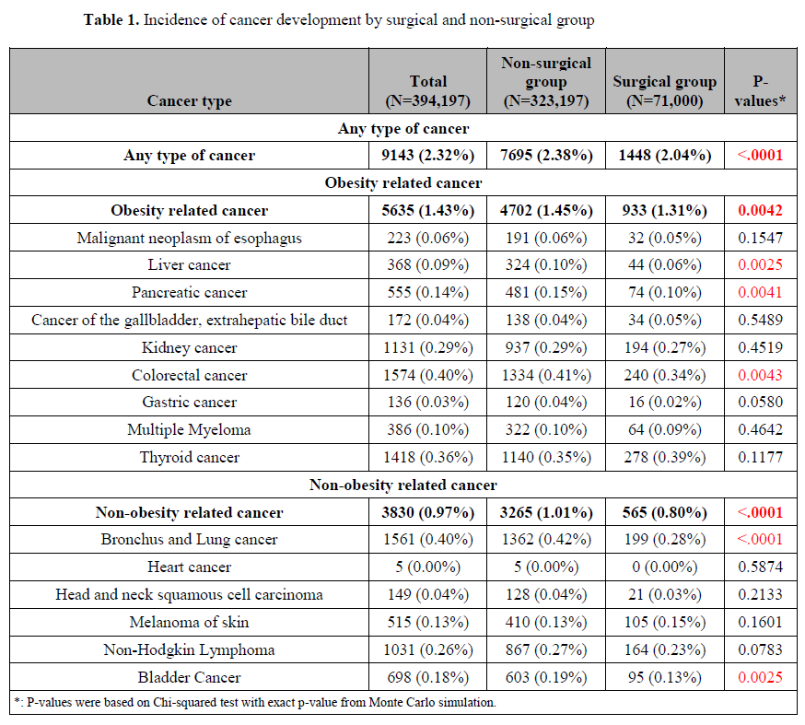
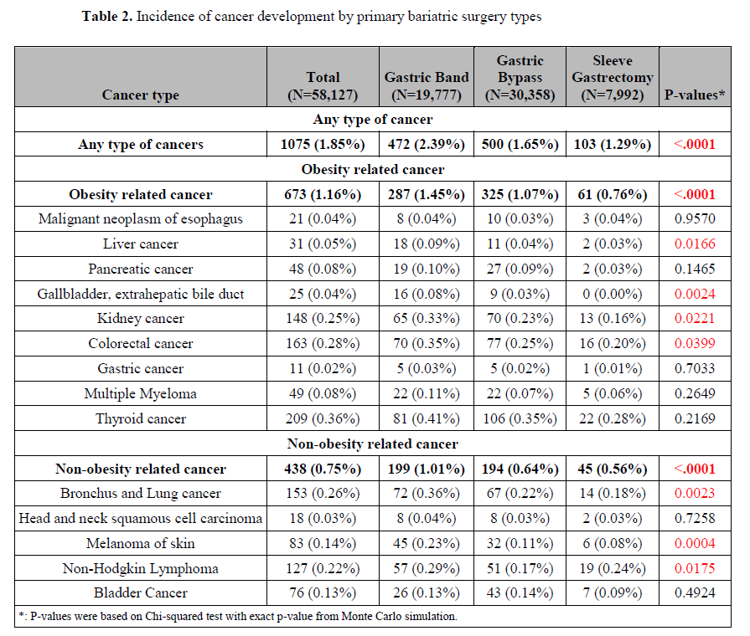
Chirurgia Bariatrica e Metabolica e cancro: si può parlare di prevenzione?
2020
Tsui ST, Yang J, Zhang X, Docimo S Jr, Spaniolas K, Talamini MA, Sasson AR, Pryor AD. Development of cancer after bariatric surgery. Surg Obes Relat Dis. 2020 Oct;16(10):1586-1595.

Slide 23
Chirurgia Bariatrica e Metabolica e cancro: si può parlare di prevenzione?
2020
Highlights:
· Bariatric Surgery patients had a lower risk of cancer than non-surgery patients
· Roux-en-Y gastric bypass patients had the lowest risk of any type of cancer
· Expansion of bariatric indications for reducing the risk of cancer may be warranted
Tsui ST, Yang J, Zhang X, Docimo S Jr, Spaniolas K, Talamini MA, Sasson AR, Pryor AD. Development of cancer after bariatric surgery. Surg Obes Relat Dis. 2020 Oct;16(10):1586-1595.

Slide 24
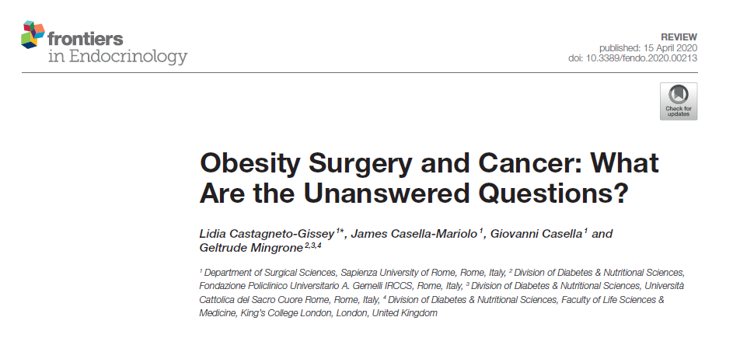
Chirurgia Bariatrica e Metabolica e cancro: si può parlare di prevenzione?
2020
Cancer risk worldwide attributable to overweight and obesity, according to gender.
(A) Females; (B) Males.
Castagneto-Gissey L, Casella-Mariolo J, Casella G, Mingrone G. Obesity Surgery and Cancer: What Are the Unanswered Questions? Front Endocrinol (Lausanne). 2020 Apr 15;11:213.

Slide 25
Chirurgia Bariatrica e Metabolica e cancro: si può parlare di prevenzione?
2020
Which Types of Cancers Benefit More From BMS?
MBS appears to have protective effects on cancer development This anticarcinogenic action is multifactorial and includes weight-dependent and independent mechanisms. There is a lack of correlation between the entity of weight loss after BMS and the decrease in cancer incidence. This is to confirm how BMS exercises its effects not solely through weight loss, but is rather likely to be mediated by various mechanisms
Does Only Cancer Risk Improve or Is Also Prognosis Affected After BMS? MBS not only affects cancer incidence but has also been shown to profoundly influence cancer prognosis. This may occur through several pathways that are in part correlated to weight loss but also involve multiple mechanisms that go beyond mere weight reduction and that seem to be associated to metabolic modifications occurring after surgery. In fact, evidence suggests that cancer prognosis is affected by insulin and IGF- 1 circulating levels, independently of cancer risk. Specifically, a state of hyperinsulinemia is associated with worst cancer prognosis and outcomes
Which Operation Should Be Recommended for Each Specific Type of Cancer?
No evidence is available at present regarding the beneficial effects of different bariatric procedures on specific cancer types. In consideration of this, the various surgical bariatric procedures available should be advised by the bariatric surgeon based on the preoperative work-up and available institutional and international guidelines
Castagneto-Gissey L, Casella-Mariolo J, Casella G, Mingrone G. Obesity Surgery and Cancer: What Are the Unanswered Questions? Front Endocrinol (Lausanne). 2020 Apr 15;11:213.

Slide 26
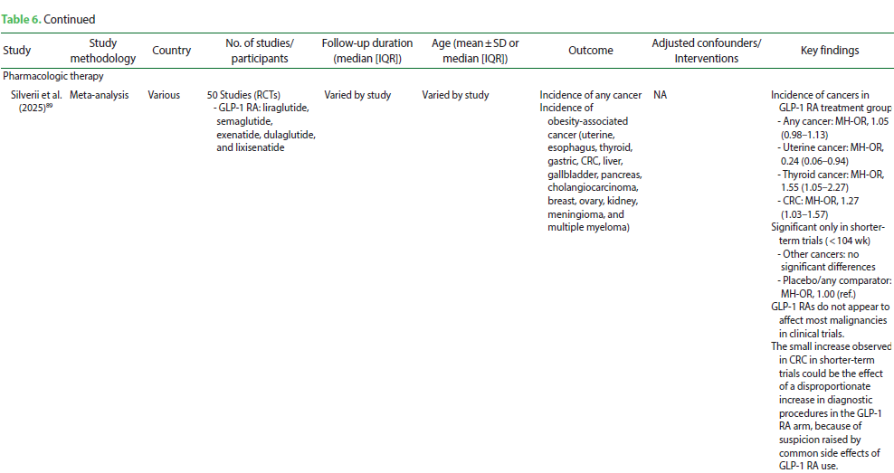
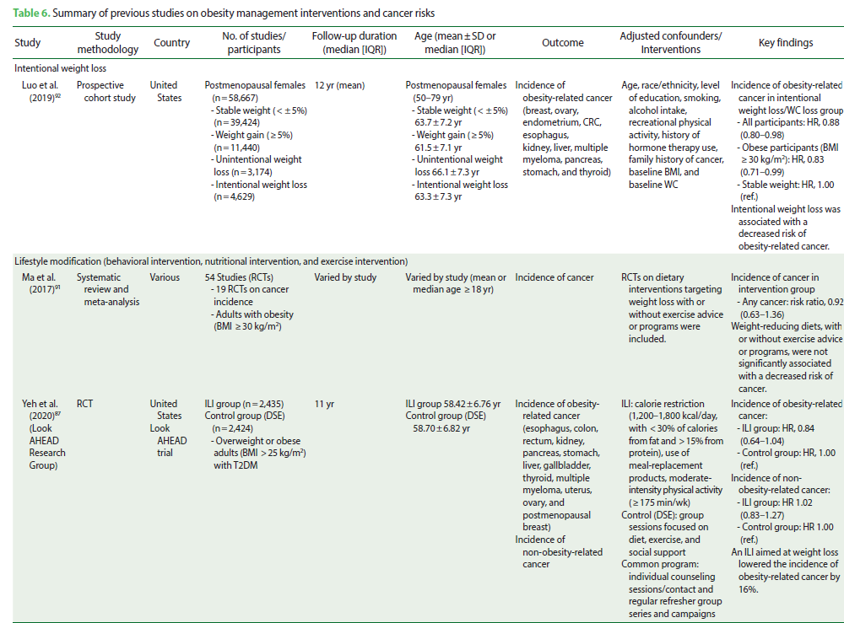
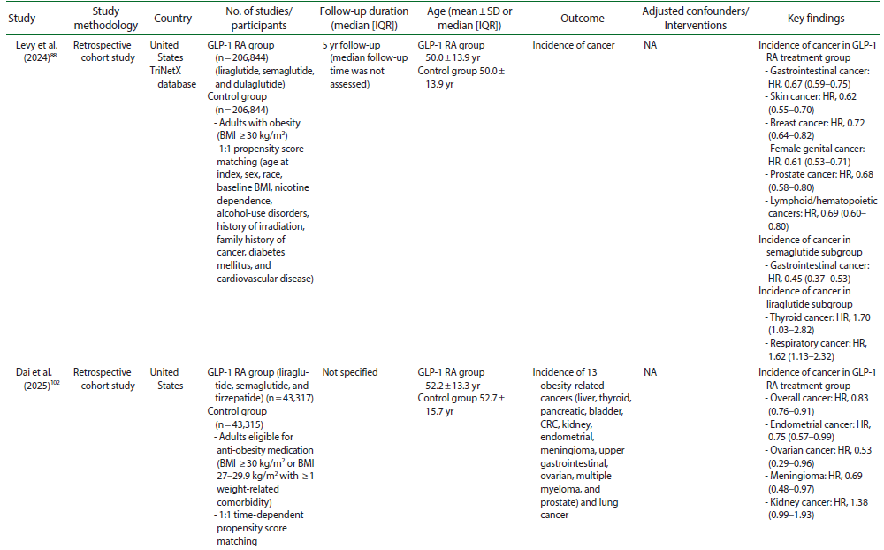
Chirurgia Bariatrica e Metabolica e cancro: si può parlare di prevenzione?
2026
Lim JS, Kim S, Cho IY, Shin DW. Obesity and Cancer: Mechanisms, Epidemiological Evidence, and Potential Risk Reduction. J Obes Metab Syndr. 2026 Jan 30;35(1):14-37.

Slide 27
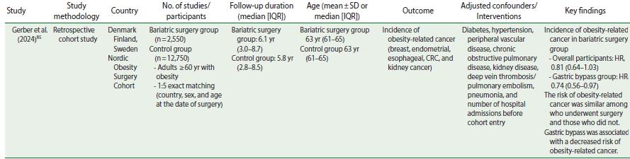
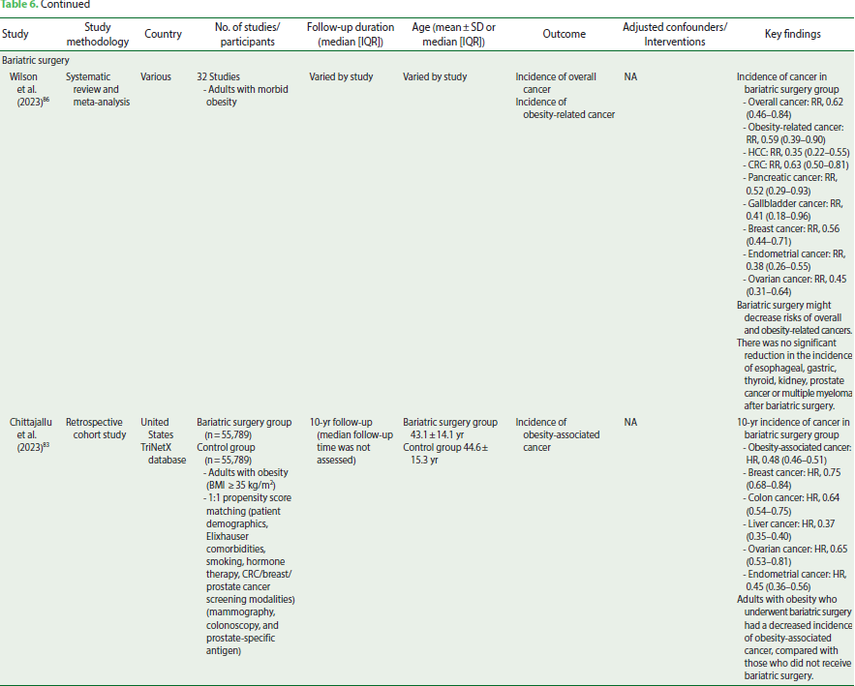
Chirurgia Bariatrica e Metabolica e cancro: si può parlare di prevenzione?
2026
Lim JS, Kim S, Cho IY, Shin DW. Obesity and Cancer: Mechanisms, Epidemiological Evidence, and Potential Risk Reduction. J Obes Metab Syndr. 2026 Jan 30;35(1):14-37.

Slide 28
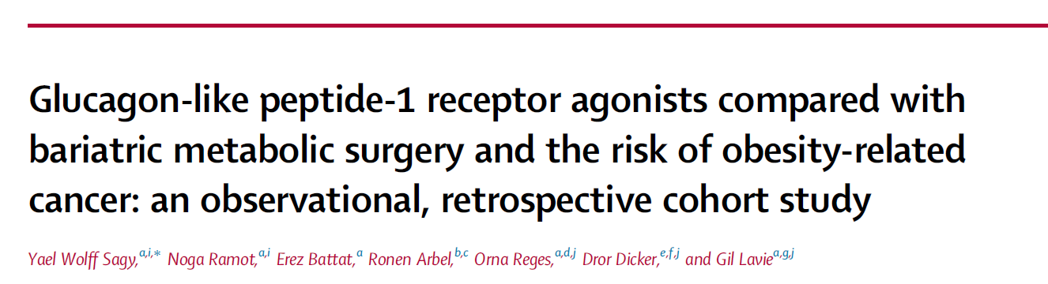
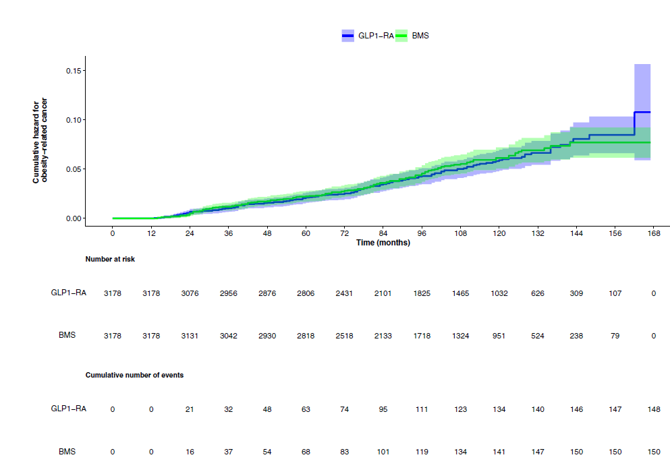
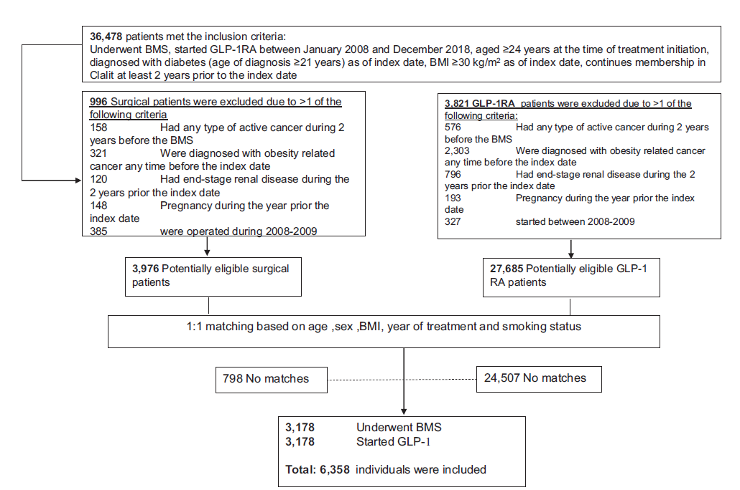
Chirurgia Bariatrica e Metabolica e cancro: si può parlare di prevenzione?
2025
Wolff Sagy Y, Ramot N, Battat E, Arbel R, Reges O, Dicker D, Lavie G. Glucagon-like peptide-1 receptor agonists compared with bariatric metabolic surgery and the risk of obesity-related cancer: an observational, retrospective cohort study. EClinicalMedicine. 2025 May 11;83:103213.

Slide 29
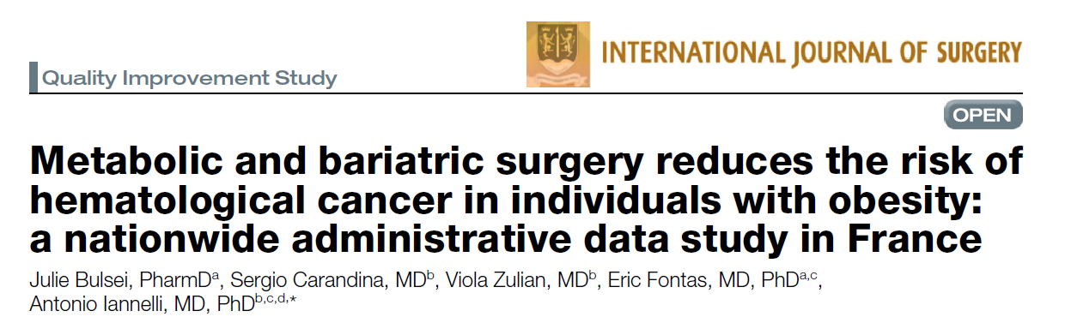
Chirurgia Bariatrica e Metabolica e cancro: si può parlare di prevenzione?
2025
The main analysis showed a significant reduction in the risk of Hodgkin lymphoma (0.511 [0.332–0.787]), non-Hodgkin lymphomas (0.467 [0.369–0.591]), leukemia (0.563 [0.452–0.702]) and multiple myeloma (0.389 [0.268–0.566]) in the MBS group after adjusting for age, sex, obesity severity and risk factors for hematological cancer.
The propensity score analysis (139 414 individuals in the MBS group versus 278 828 in the control group) confirmed these results. The protective effect of MBS was
consistent across genders and type of surgery.
MBS is associated with a significant reduction in the risk of hematological cancer in men and women and sleeve gastrectomy and Roux-en-Y gastric bypass are equally effective.
Bulsei J, Carandina S, Zulian V, Fontas E, Iannelli A. Metabolic and bariatric surgery reduces the risk of hematological cancer in individuals with obesity: a nationwide administrative data study in France. Int J Surg. 2025 Oct 1;111(10):6970-6977.

Slide 30
Chirurgia Bariatrica e Metabolica e cancro: si può parlare di prevenzione?
2025
Bulsei J, Carandina S, Zulian V, Fontas E, Iannelli A. Metabolic and bariatric surgery reduces the risk of hematological cancer in individuals with obesity: a nationwide administrative data study in France. Int J Surg. 2025 Oct 1;111(10):6970-6977.

Slide 31











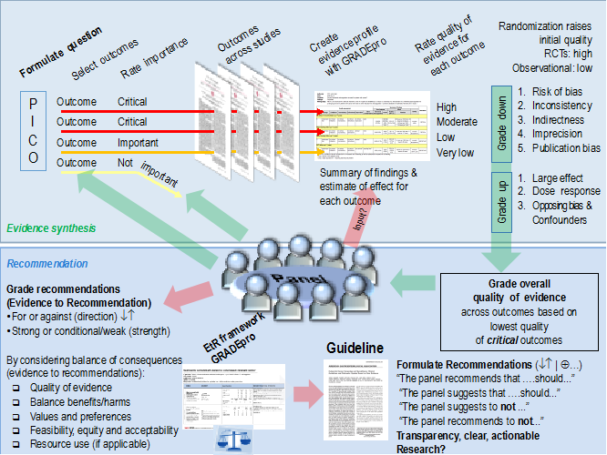
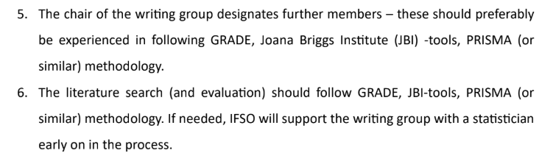

IFSO POSITION STATEMENT WRITING TASK FORCE
Co-coordinator
Amanda
Belluzzi
Matteo
Monami
Coordinator: Maurizio De Luca
Miguel Herrera
Ricardo
Cohen
Michel
Suter
Ashraf
Haddad
Lilian Kow
Ali
Aminian
Wendy
Brown

Slide 32
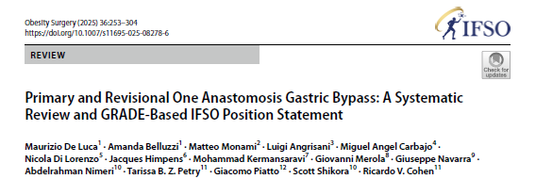
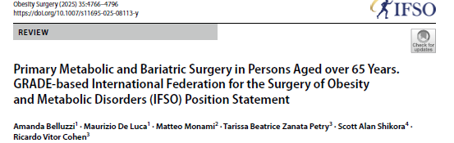
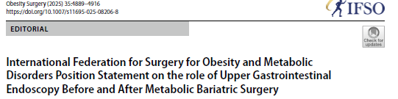
IFSO POSITION STATEMENT WRITING TASK FORCE
On going:
MBS as a Strategy for Cancer Prevention and Management in Patients with Obesity.
Robotic MBS
MBS and MASLD
Recently published PS
OAGB both in Primary and Revisional Setting
Role of MBS in Elderly Population
Role of Upper Gastrointestinal Endoscopy Before and After MBS
Same-Day Discharge MBS(published yesterday)
Ring-augmented MBS procedures(published yesterday)
Belluzzi A, De Luca M, Monami M, Petry TBZ, Shikora SA, Cohen RV. Primary Metabolic and Bariatric Surgery in Persons Aged over 65 Years. GRADE-based International Federation for the Surgery of Obesity and Metabolic Disorders (IFSO) Position Statement. Obes Surg. 2025 Nov;35(11):4766-4796.
De Luca M, Belluzzi A, Monami M, Angrisani L, Carbajo MA, Di Lorenzo N, Himpens J, Kermansaravi M, Merola G, Navarra G, Nimeri A, Petry TBZ, Piatto G, Shikora S, Cohen RV. Primary and Revisional One Anastomosis Gastric Bypass: A Systematic Review and GRADE-Based IFSO Position Statement. Obes Surg. 2026 Jan;36(1):253-304.
Brown WA, Fisher OM, Johari Y, Au J, Stier C, Moore R, Parmar C, Dixon JB, Salminen P. International Federation for Surgery for Obesity and Metabolic Disorders Position Statement on the role of Upper Gastrointestinal Endoscopy Before and After Metabolic Bariatric Surgery. Obes Surg. 2025 Dec;35(12):4889-4916. doi: 10.1007/s11695-025-08206-8.

Slide 33

Chirurgia Bariatrica e Metabolica e cancro: si può parlare di prevenzione?
Metabolic and Bariatric Surgery as a Strategy for Cancer Prevention and Management in Patients with Obesity. A GRADE-based IFSO Position Statement.
Amanda Belluzzi, Maurizio De Luca et al
Key points:
• No RCT evidence exists evaluating cancer incidence after metabolic and bariatric surgery (MBS) in adults with obesity; evidence synthesis relies on observational studies.
• A large observational evidence base (191 studies) suggests MBS is generally associated with lower incidence of several obesity-related cancers, with the most consistent signals for hormone-sensitive malignancies.
• Potential cancer risk reduction may be discussed as an additional benefit when MBS is performed for standard metabolic indications, but it should not be offered solely for cancer prevention; recommendations are therefore conditional.
Site-specific cancer incidence
Across retrospective matched and unmatched cohort studies, MBS was generally associated with lower incidence rates of several obesity-related cancers compared with non-surgical control groups.
More consistent inverse associations were observed for hormone-sensitive malignancies. Reduced incidence following MBS was reported for postmenopausal breast cancer ,corpus uteri and endometrial cancer and ovarian cancer ,with most pooled estimates below unity, although confidence intervals crossed the null in some analyses.
For gastrointestinal cancers, point estimates also predominantly favored MBS.
Inverse associations were observed for esophageal cancer ,colorectal cancer ,gastric cancer ,liver cancer , gallbladder cancer and pancreatic cancer .

Slide 34
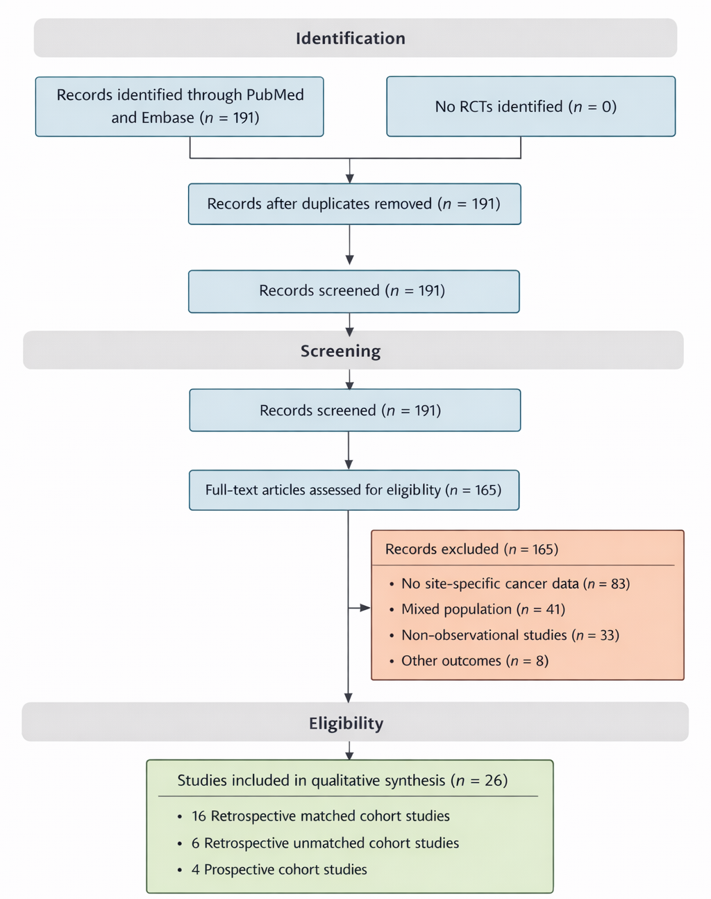
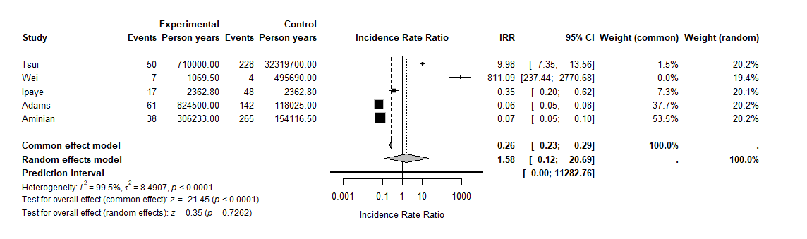
Chirurgia Bariatrica e Metabolica e cancro: si può parlare di prevenzione?
Forest plot of incidence rate ratios (IRRs) for postmenopausal breast cancer incidence comparing bariatric surgery with non-surgical control groups in retrospective matched cohort studies.
Forest plot of incidence rate ratios (IRRs) for endometrial cancer incidence comparing bariatric surgery with non-surgical control groups in retrospective matched cohort studies.

Slide 35
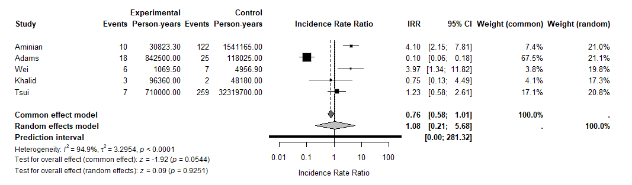
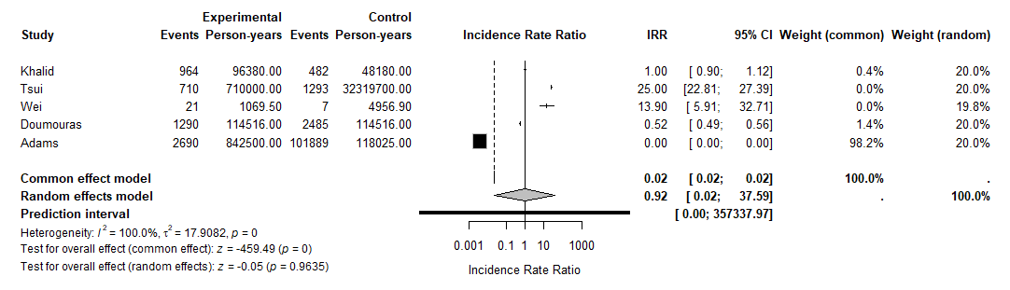
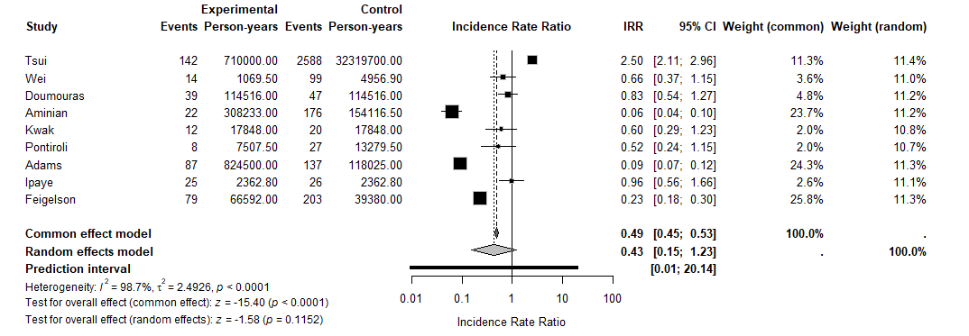
Chirurgia Bariatrica e Metabolica e cancro: si può parlare di prevenzione?
Forest plot of incidence rate ratios (IRRs) for esophageal cancer incidence comparing bariatric surgery with non-surgical control groups in retrospective matched cohort studies
Forest plot of incidence rate ratios (IRRs) for gastric cancer incidence comparing bariatric surgery with non-surgical control groups in retrospective matched cohort studies
Forest plot of incidence rate ratios (IRRs) for colorectal cancer incidence comparing bariatric surgery with non-surgical control groups in retrospective matched cohort studies

Slide 36

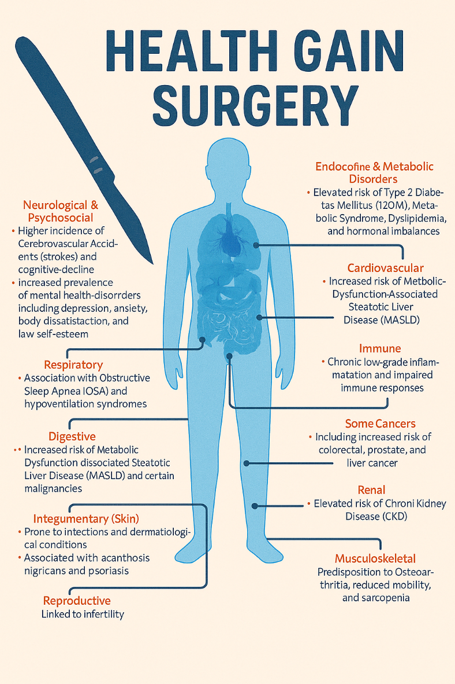
Chirurgia Bariatrica e Metabolica e cancro: si può parlare di prevenzione?
Take home messages
Obesity is a chronic, relapsing, progressive disease of excess adiposity.
Obesity increases the risk of developing at least 13 types of cancer.
MBS is associated with a lower risk of invasive cancer.
Weight loss of any type should be suggested by clinicians to patients as a preventive measure to reduce their risk of developing cancer and improve cancer prognosis
Cancer incidence is mandatory to be reported in bariatric registries
Attacking obesity-related diseases at the source - Is bariatric surgery the next wave in cancer prevention?

Slide 37

Grazie

